Slide 1

NATIONAL INSTITUTE OF TECHNOLOGY SIKKIM
Department of Computer Science and Engineering
An efficient decision tree Network Intrusion Detection based on Recursive feature elimination
Major Project Part-2
CS18201
Project Supervisor
Mr. Pankaj Kumar Keserwani
Assistant Professor
Submitted by
Aditya Yadav B170071CS

Slide 2

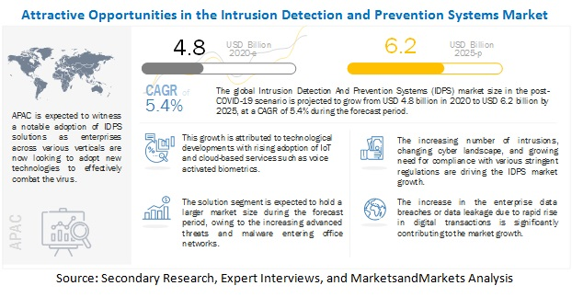
MOTIVATION
Traditional Security Solutions
Traditional network security solutions may not be directly applicable due to the differences in IoT structure and behavior.
Discussion with Project Supervisor
Healthy class discussions about recent issues, challenges, and solutions by ML and DL methods to solve arose interests in the field.
Journals and Paper Readings
During the project I have read many research and journal papers related to intrusion detection system led me to work upon this field.
Recent IoT networks have become an increasingly valuable target of malicious attacks due to the increased amount of valuable user data they contain. In response, network intrusion detection systems have been developed to detect suspicious network activity.

Slide 3
INTRODUCTION
Network intrusions are becoming more frequent and advanced day by day. Problem arises of how to capture the intrusions in such a large-scale network which now requires a scalable solution.
Network intrusion detection systems (NIDS) performs an observation on entire network traffic that is passed on the subnets to the collection of known attacks. Once an attack is identified or abnormal behavior is observed, the alert can be sent to the administrator.
Some intrusion attacks addressed are : DOS, PROBE,R2L, U2R.
Recently, machine learning (ML) and deep learning (DL)‐based IDS systems are being deployed as potential solutions to detect intrusions across the network in an efficient manner.

Slide 4
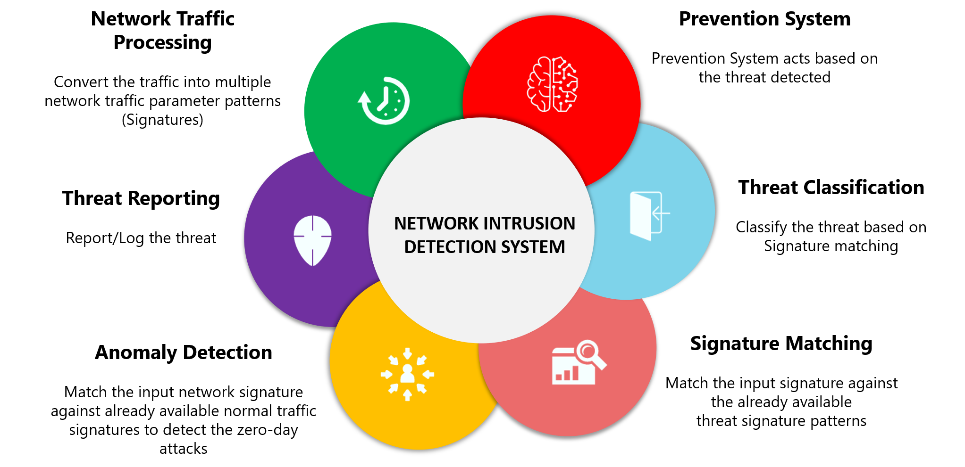
Why Network Intrusion Detection?
A network intrusion detection system (NIDS) is crucial for network security because it enables you to detect and respond to malicious traffic. The primary benefit of an intrusion detection system is to ensure IT personnel is notified when an attack or network intrusion might be taking place.

Slide 5
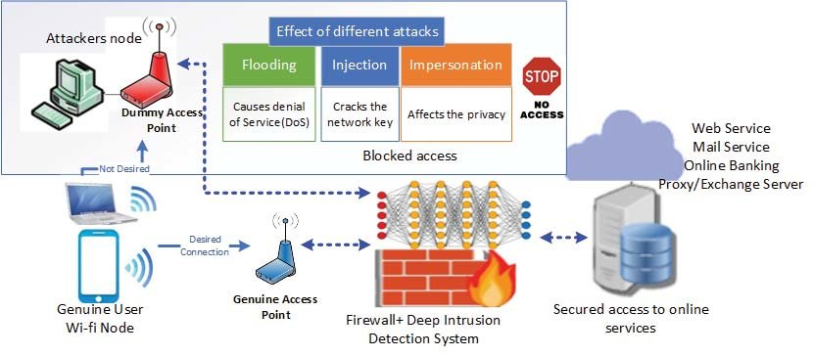
How Network Intrusion Detection works ?

Slide 6
BACKGROUND STUDY
An Intrusion Detection System (IDS) is a system that monitors network traffic for suspicious activity and issues alerts when such activity is discovered.
IDS are classified into 5 types:
Network Intrusion Detection System (NIDS)
Host Intrusion Detection System (HIDS)
Hybrid Intrusion Detection System
Protocol-based Intrusion Detection System (PIDS)
Application Protocol-based Intrusion Detection System (APIDS)
Detection Method of IDS:
Signature-based Method
Anomaly-based Method
Comparison of IDS with Firewalls

Slide 7
RELATED WORK
Bahareh [1] proposed an intrusion detection system on the NSL-KDD dataset. In the study, Principal Component Analysis (PCA), Factor Analysis, Kernel PCA and Bottleneck (Auto encoder) methods are used and compared as pre-processing step and classification by using artificial neural network classifier. Achieved accuracy are, 86.78 %, 88.31%, and 88.53% obtained using PCA, Kernel PCA and Factor Analysis respectively. Highest accuracy rate is achieved as 91.46% with auto-encoder that is provided by using bottleneck feature extraction.
Jia et al. [2] proposed a new deep neural network model to apply to the IDS. The model with four hidden layers improves the detection rate and detection accuracy on the KDD and NSL dataset. However, the experiment showed that the accuracy of U2R is only 90.91%.
Li et al. [3] (Building auto-encoder intrusion detection system based on random forest feature selection) In this study the best features were selected by RF, and the train to test ratio was set as 85–15. The Affinity Propagation (AP) clustering algorithm used to group features into subsets, which were relayed to the autoencoder. Recall rates for all attack types for the proposed model were compared with those of another autoencoder model called Kitnet.

Slide 8
Problem Statement
IDSs based on ML methods are effective and accurate in detecting networks attacks. However, the performance of these systems decreases for high dimensional data spaces. There are many network intrusions dataset work upon any network attacks related dataset like UNSW-NB15, NSL KDD,CICIDS etc. which includes many irrelevant features or features having vey very least dependency on outcome variable so it drastically decreasing the rate of intrusion detection and increasing false alarm rate. Here aim is to propose a relevant feature extraction technique in order to obtain more accuracy and decrease false alarm rate. Apply a proper classification algorithms to train a model which detects the attacks in a network with better performance. Compare with other feature extraction and classifier algorithms of previous done researches with your proposed method.

Slide 9
OBJECTIVES
To identify the most significant features extraction mechanism of Intrusion detection on any network attacks dataset.
ANOVA F TEST
Recursive feature elimination (RFE)
Comparing Machine learning based approaches with reduced feature set and all features by measuring respective performance metric score.
Obtain better accuracy and decreased false alarm rate with strongest and reduced features by RFE algorithm proposed.

Slide 10
Approach
Data Preprocessing
Response Features
CSV processed with:
1-Pandas, NumPy, scikitLearn
2-Remove NaN`s
3-Training & Testing 4-Encoding Transformation
1 -Attack or Normal
2 –Attack Classification
(DOS, PROBE, R2L, U2R)
1
2
3
4
Feature Selection
ML algorithms:
1-Univariate feature selection
using ANOVA F-Test
2-Feature reduction using Recursive
feature elimination
3-13-most relevant features ranked
Model Building & Evaluation
Build Decision tree model to classify category of attacks and network intrusions.
Compare metric scores on relevant features and all features for model inspection.

Slide 11
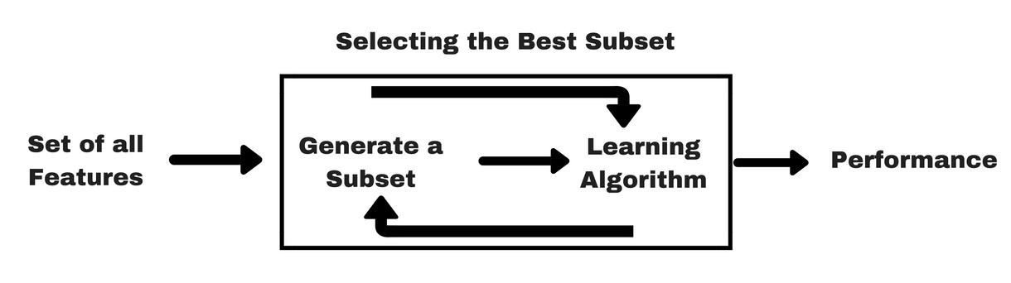
ANOVA F-TEST Univariate Feature Selection
Analysis of variance (ANOVA) can determine whether the means of three or more groups are different. ANOVA uses F-tests to statistically test the equality of means.
The F-statistic is simply a ratio of two variances. Variance is the square of the standard deviation.
Variances are a measure of dispersion, or how far the data are scattered from the mean. Larger values represent greater dispersion.
Recursive Feature Elimination

Slide 12
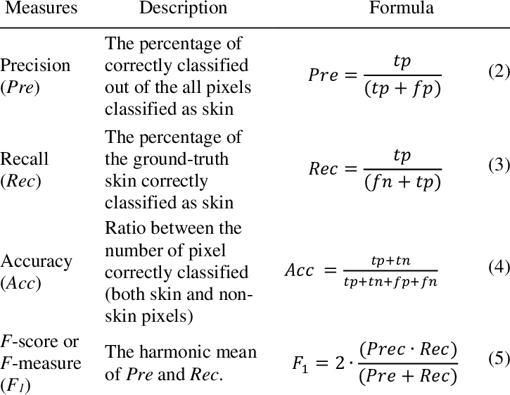
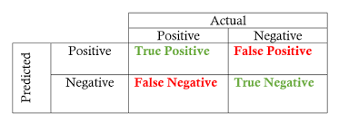
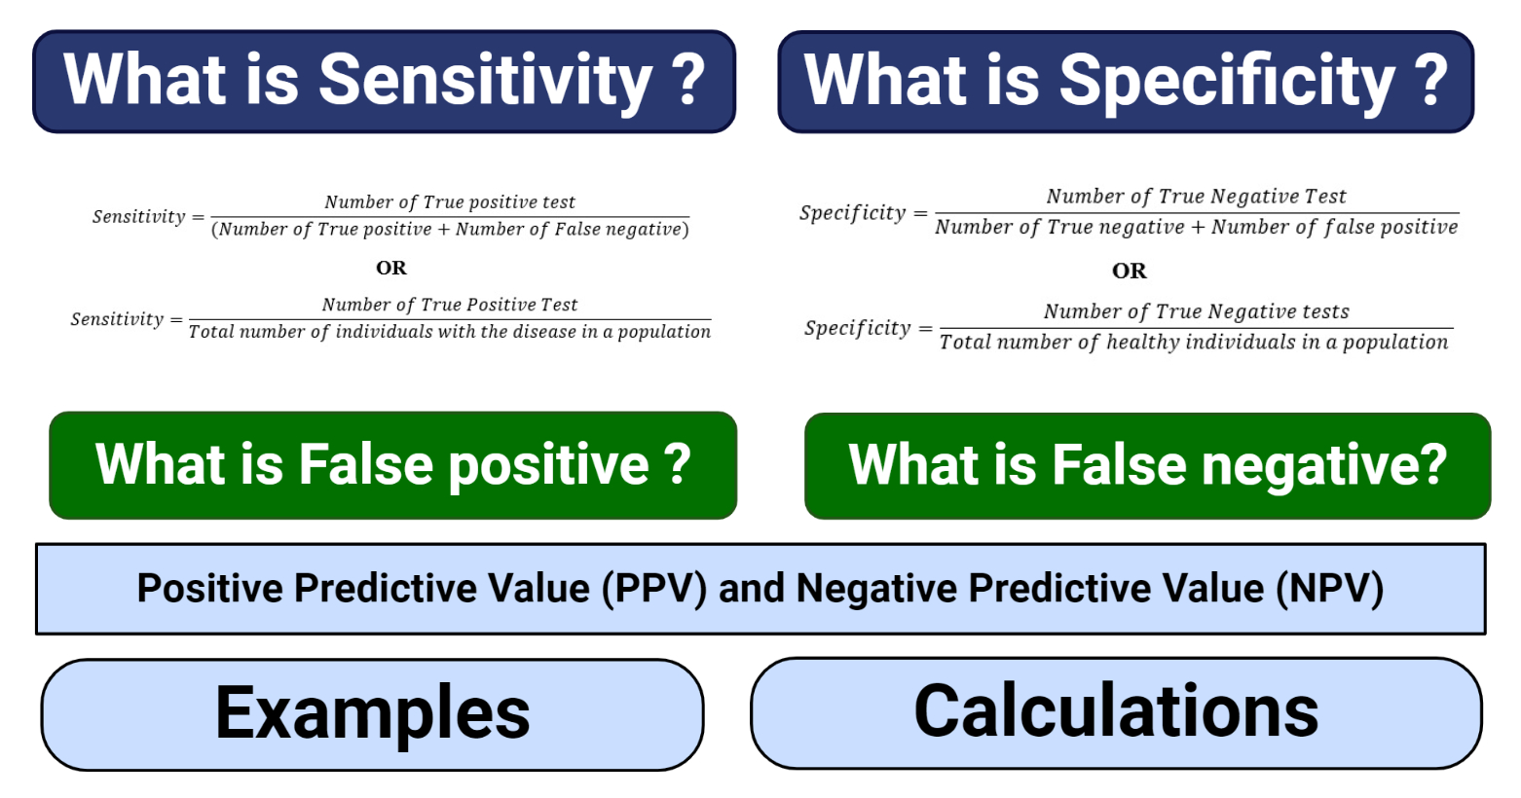
Performance comparison Criterion
Confusion Matrix

Slide 13
IMPLEMENTATION RESULTS
On implementation of the proposed method having feature elimination technique of ANOVA F- TEST and then Recursive feature elimination (RFE) most relevant features extracted and then decision tree model is used to classify the category of attacks and following values on performance metrics score is calculated as shown in below table:
TABLE 1 : PERFORMANCE EVALUATION WITH SELECTED FEATURES

Slide 14
CONCLUSION
The feature selection method proposed had achieved a high result in term of accuracy and features that are identified are based on information gain and feature ranking technique.
A presentation and implementation of a feature selection method which consist of a univariate features selection (ANOVA-F) associated with a recursive feature elimination (RFE subset feature elimination) by building a decision tree classifier model for identifying all the relevant features have been done.
During this work process repeatedly builds a model placing the feature aside and then repeating the process with the remaining features until all features present in the dataset are diminished.
The evaluation of the relevancy of the method using different classification metric measurement has been made and it has been proved that by reducing the number of features to 13, the accuracy of the model is improved.

Slide 15
REFERENCES
B. Abolhasanzadeh, "Nonlinear dimensionality reduction for intrusion detection using auto-encoder bottleneck features," 2015 7th Conference on Information and Knowledge Technology (IKT), 2015, pp. 1-5, doi: 10.1109/IKT.2015.7288799.
Y. Jia, M. Wang, and Y. Wang, “Network intrusion detection algorithm based on deep neural network,” IET Information Security, vol. 13, no. 1, pp. 48–53, 2019.
Li X, Chen W, Zhang Q, Wu L. Building auto-encoder intrusion detection system based on random forest feature selection. Comput Secur. 2020;95:101851.
KDD Dataset details accessed https://kdd.ics.uci.edu/databases/kddcup99/task.html
Feature selection accessed https://towardsdatascience.com/feature-selection-techniques-in-machine-learning-with-python-f24e7da3f36e
Khraisat, A., Gondal, I., Vamplew, P. et al. Survey of intrusion detection systems: techniques, datasets and challenges. Cybersecur 2, 20 (2019). https://doi.org/10.1186/s42400-019-00387

Slide 16
Thank You

